Slide 1

COMPUTER NETWORKS MODULE 3 PHYSICAL LAYER
By
Dr. Kanchan Shende

Slide 2
Digital Transmission : Line Coding Scheme
A computer network is designed to send information from one point to another.
This information needs to be converted to either a digital signal or an analog signal for transmission.
DIGITAL TO DIGITAL CONVERSION
The conversion involves three techniques:
Line coding
Block coding
Scrambling.
SOCS, MIT-WPU

Slide 3
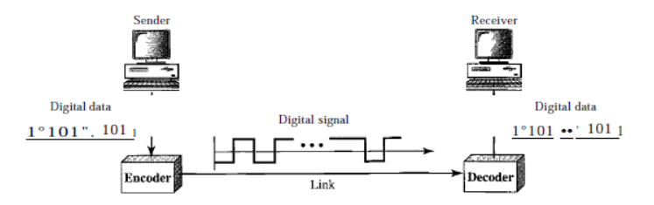
Conti…
Line Coding Scheme
Line coding is the process of converting digital data to digital signals.
Line coding converts a sequence of bits to a digital signal.
At the sender, digital data are encoded into a digital signal;
At the receiver, the digital data are recreated by decoding the digital signal.
SOCS, MIT-WPU

Slide 4
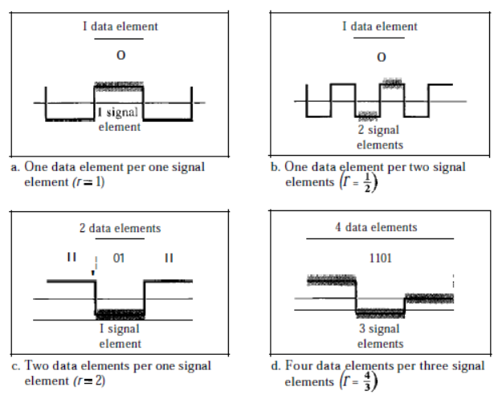
Characteristics of Line Coding Scheme
1. Signal Element Versus Data Element
In data communications, our goal is to send data elements.
A data element is the smallest entity that can represent a piece of information: this is the bit.
In digital data communications, a signal element carries data elements.
A signal element is the shortest unit (timewise) of a digital signal.
In other words, data elements are what we need to send; signal elements are what we can send.
SOCS, MIT-WPU

Slide 5
2. Data Rate Versus Signal Rate
The data rate defines the number of data elements (bits) sent in per second. The unit is bits per second (bps).
The signal rate is the number of signal elements sent in per second. The unit is the baud.
The data rate is sometimes called the bit rate; the signal rate is sometimes called the pulse rate, the modulation rate, or the baud rate.
One goal in data communications is to increase the data rate while decreasing the signal rate.
Increasing the data rate increases the speed of transmission; decreasing the signal rate decreases the bandwidth requirement.
SOCS, MIT-WPU

Slide 6
Characteristics of Line Coding Scheme
Data Rate Versus Signal Rate
The data rate defines the number of data elements (bits) sent in per second. The unit is bits per second (bps).
The signal rate is the number of signal elements sent in per second. The unit is the baud.
The data rate is sometimes called the bit rate; the signal rate is sometimes called the pulse rate, the modulation rate, or the baud rate.
One goal in data communications is to increase the data rate while decreasing the signal rate.
Increasing the data rate increases the speed of transmission; decreasing the signal rate decreases the bandwidth requirement.
SOCS, MIT-WPU

Slide 7
Conti….
We now need to consider the relationship between data rate and signal rate (bit rate and baud rate).
This relationship, of course, depends on the value of r. It also depends on the data pattern.
If we have a data pattern of all 1s or all 0s, the signal rate may be different from a data pattern of alternating 0s and 1s.
To derive a formula for the relationship, need to define three cases: the worst, best, and average.
The worst case is when we need the maximum signal rate; the best case is when we need the minimum.
In data communications, we are usually interested in the average case.
We can formulate the relationship between data rate and signal rate as
SOCS, MIT-WPU

Slide 8

Conti….
We can formulate the relationship between data rate and signal rate as
Where, N is is the data rate (bps);
c is the case factor, which varies for each case;
S is the number of signal elements;
r is the previously defined factor.
SOCS, MIT-WPU

Slide 9
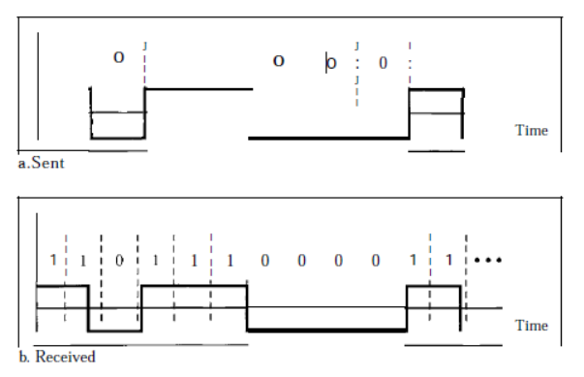
3. Self-synchronization
To correctly interpret the signals received from the sender, the receiver's bit intervals must correspond exactly to the sender's bit intervals.
If the receiver clock is faster or slower, the bit intervals are not matched and the receiver might misinterpret the signals.
Example: Figure shows a situation in which the receiver has a shorter
bit duration.
The sender sends 10110001, while the receiver receives 110111000011.
A self-synchronizing digital signal includes timing information in the data being transmitted.
This can be achieved if there are transitions in the signal that alert the receiver to the beginning, middle, or end of the pulse.
SOCS, MIT-WPU

Slide 10
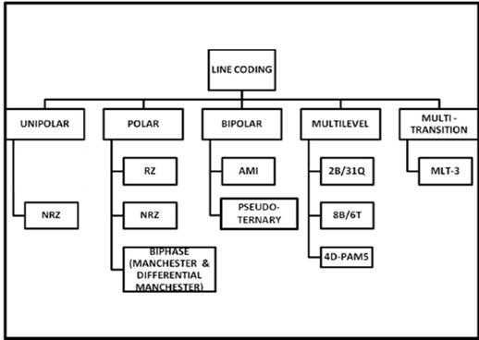
Line Coding Schemes
Line Coding
Unipolar
Polar
Bipolar
Multilevel
Multitransition
SOCS, MIT-WPU

Slide 11
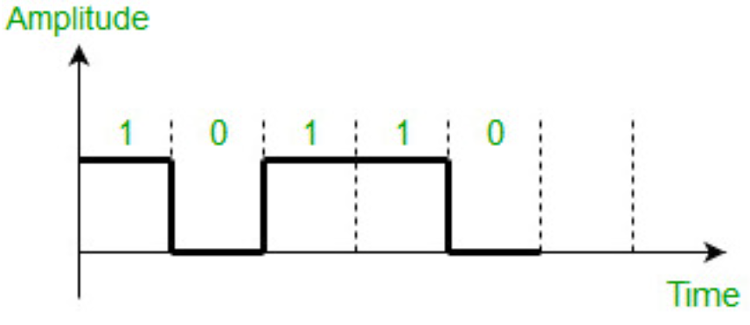
Conti….
1. Unipolar Scheme
In a unipolar scheme, all the signal levels are on one side of the time axis, either above or below.
Non return to zero (NRZ) – Traditionally, a unipolar scheme was designed as a non-return-to-zero (NRZ) scheme in which the positive voltage defines bit 1 and the zero voltage defines bit 0.
Signal does not return to zero at the middle of the bit thus it is called NRZ.
SOCS, MIT-WPU

Slide 12
Conti….
2. Polar Scheme
In polar schemes, the voltages are on the both sides of the time axis.
For example, the voltage level for 0 can be positive and the voltage level for 1 can be negative.
NRZ-L and NRZ-I – These are somewhat similar to unipolar NRZ scheme but here use two levels of amplitude (voltages).
For NRZ-L(NRZ-Level), the level of the voltage determines the value of the bit, typically binary 1 maps to logic-level high, and binary 0 maps to logic-level low,
NRZ-I(NRZ-Invert), two-level signal has a transition at a boundary if the next bit that we are going to transmit is a logical 1, and does not have a transition if the next bit that we are going to transmit is a logical 0.
SOCS, MIT-WPU

Slide 13
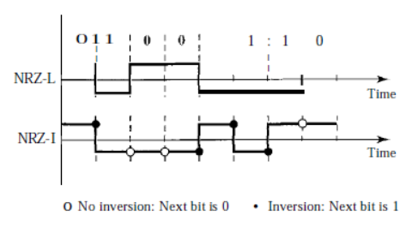
Conti….
NRZ: NRZ-Land NRZ-I, as shown in above figure
In the first variation, NRZ-L (NRZ-Level), the level of the voltage determines
the value of the bit.
In the second variation, NRZ-I (NRZ-Invert), the change or lack of change in the level of the voltage determines the value of the bit.
If there is no change, the bit is 0; if there is a change, the bit is 1.
SOCS, MIT-WPU

Slide 14
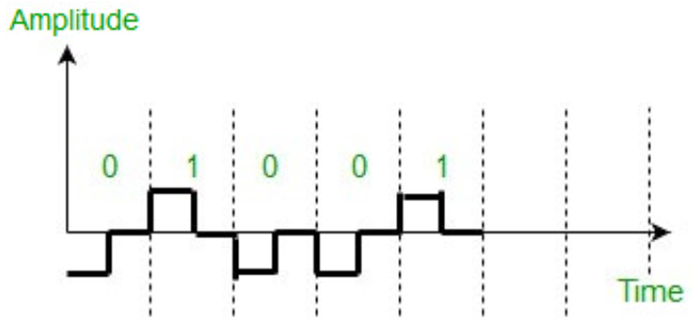
Conti….
Return to zero (RZ) : RZ scheme, which uses three values positive, negative, and zero.
In this scheme signal goes to 0 in the middle of each bit.
Note – The logic we are using here to represent data is that
For bit 1 half of the signal is represented by +V and half by zero voltage
For bit 0 half of the signal is represented by -V and half by zero voltage. Example: Data = 01001.
SOCS, MIT-WPU

Slide 15
Conti….
Main disadvantage of RZ encoding is that it requires greater bandwidth.
Another problem is the complexity as it uses three levels of voltage.
As a result of all these deficiencies, this scheme is not used today.
Instead, it has been replaced by the better-performing Manchester and differential Manchester schemes.
SOCS, MIT-WPU

Slide 16
Conti….
Biphase (Manchester and Differential Manchester )
Manchester encoding is somewhat combination of the RZ (transition at the middle of the bit) and NRZ-L schemes.
The duration of the bit is divided into two halves.
The voltage remains at one level during the first half and moves to the other level in the second half.
The transition at the middle of the bit provides synchronization.
Differential Manchester is somewhat combination of the RZ and NRZ-I schemes.
There is always a transition at the middle of the bit but the bit values are determined at the beginning of the bit. If the next bit is 0, there is a transition, if the next bit is 1, there is no transition.
SOCS, MIT-WPU

Slide 17
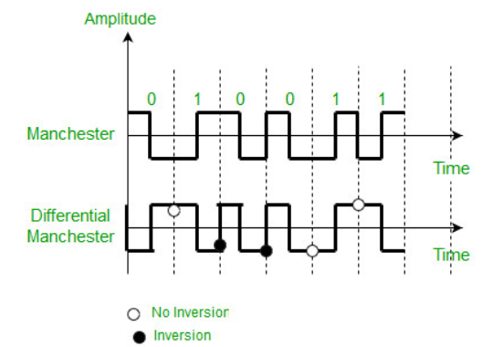
Conti….
Note – 1. The logic using here to represent data using Manchester is that for bit 1 there is transition form -V to +V volts in the middle of the bit and for bit 0 there is transition from +V to -V volts in the middle of the bit. 2. For differential Manchester we are assuming in the example that previous signal before starting of data set “010011” was positive. Therefore there is transition at the beginning and first bit “0” in current data set “010011” is starting from -V. Example: Data = 010011.
SOCS, MIT-WPU

Slide 18
Conti….
The Manchester scheme overcomes several problems associated with NRZ-L,
Differential Manchester overcomes several problems associated with NRZ-I as there is no baseline wandering and no DC component because each bit has a positive and negative voltage contribution.
Only limitation is that the minimum bandwidth of Manchester and differential Manchester is twice that of NRZ.
SOCS, MIT-WPU

Slide 19
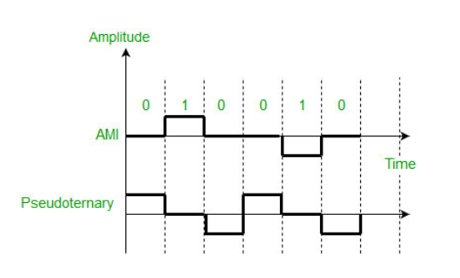
Conti….
3. Bipolar Scheme:
In this scheme there are three voltage levels positive, negative, and zero. The voltage level for one data element is at zero, while the voltage level for the other element alternates between positive and negative.
Alternate Mark Inversion (AMI) – A neutral zero voltage represents binary 0. Binary 1’s are represented by alternating positive and negative voltages.
Pseudoternary – Bit 1 is encoded as a zero voltage and the bit 0 is encoded as alternating positive and negative voltages i.e., opposite of AMI scheme.
Example:Data=010010.
SOCS, MIT-WPU

Slide 20
Conti….
4. Multilevel Scheme:
In Multilevel schemes, we increase the nnumbre of the data bits per signal element to increase the bit rate.
Our goal is to increase the number of bits carried by each signal element
Only two types of data elements in binary which are 1 and 0
A group of m data elemeents can produce a combination of 2^{m} data patterns
A pattern of m data elements is encoded into a pattern of n signal element.
SOCS, MIT-WPU

Slide 21
Conti….
1. 2B/1Q (mBnL):
mBnL
m: Length of binary pattern
B : Binary data
n: Length of signal patteren
L: number of levels
2: Length of binary pattern
B : Binary data
1: Length of signal patteren
Q: number of levels
SOCS, MIT-WPU

Slide 22
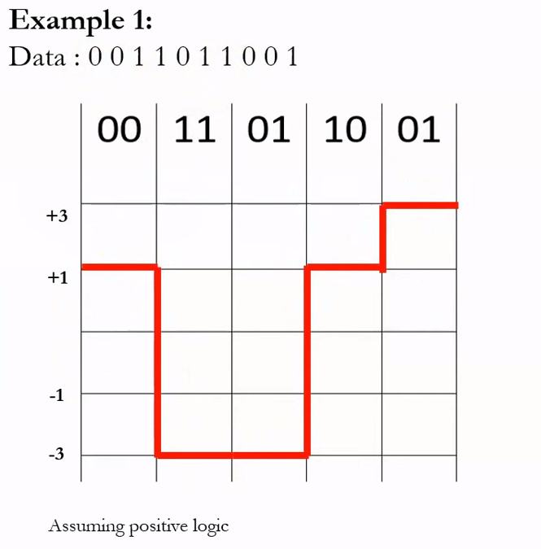
Conti….
 | Previous level positive | Previous level Negative
Next Bits | Next Level | Next Level
00 | +1 | -1
01 | +3 | -3
10 | -1 | +1
11 | -3 | +3
SOCS, MIT-WPU

Slide 23
Conti….
5. Multitransition
SOCS, MIT-WPU

Slide 24
Reference Link
https://www.tutorialspoint.com/digital_communication/digital_communication_line_codes.htm
https://www.geeksforgeeks.org/difference-between-unipolar-polar-and-bipolar-line-coding-schemes/
https://www.rfwireless-world.com/Terminology/Advantages-and-Disadvantages-of-8B6T-encoding.html#:~:text=It%20is%20multilevel%20line%20coding,used%20in%20100Base%2D4T%20cable
Book : Computer Networks By Behrouz A. Forouzan Chapter 4 : Digital Transmission
https://www.youtube.com/watch?v=6OE7aTGUA7w
https://www.youtube.com/watch?v=fVvv9NUlMxA
SOCS, MIT-WPU

